Slide 1
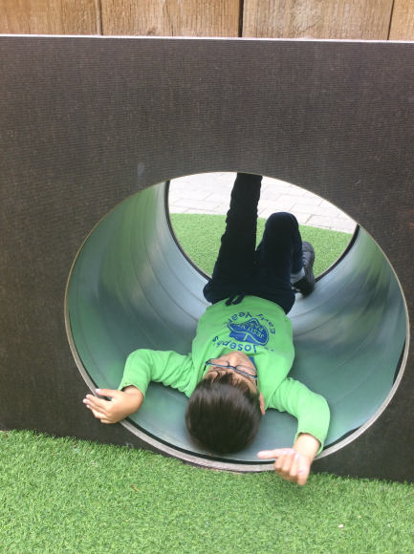
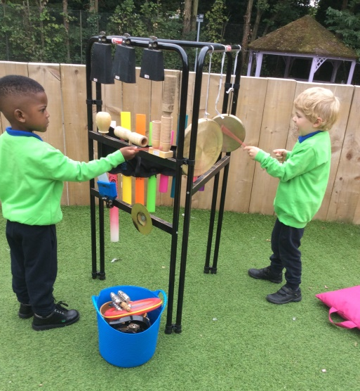
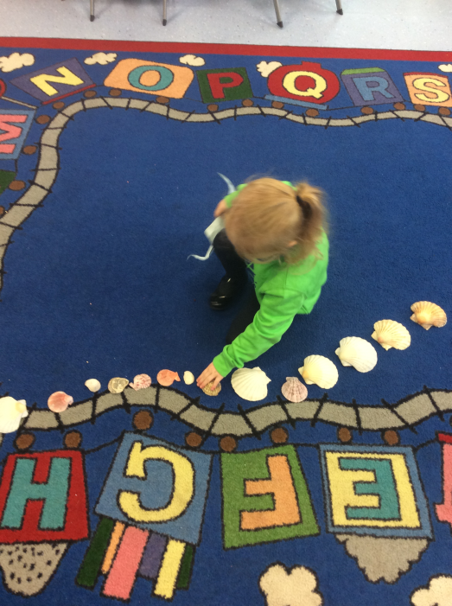
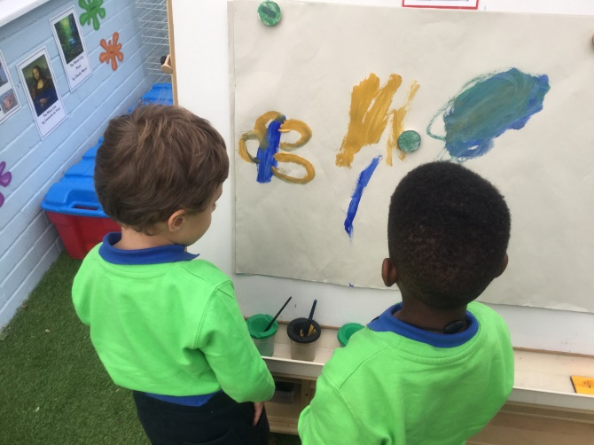
Reception Welcome Meeting
Autumn Term 2018
Thursday 27th September

Slide 2
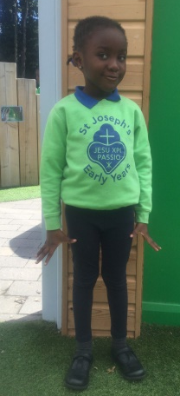
Reception Routines
A great start - Thank you
Water bottles – water only please
Packed lunches – healthy eating and no nuts in school
Library Books – changed weekly on Tuesdays (book bag)
PE –Wednesday afternoon
Clothing – please label ALL items
ALL children have 2 pairs of shoes… and wellies
School shoes
PE - plimsolls
Outdoor – Wellie boots
ALL CHILDREN TO HAVE A PAIR OF PLIMSOLLS AND WELLIES LEFT IN SCHOOL
Birthdays – own clothes and healthy treats (no nuts – we are a NUT FREE school)
Show and Tell (ONE CHILD PER DAY) Important part of our speaking and listening curriculum

Slide 3
Behaviour Expectations in Reception
Catholic ethos of the school motivates us to create a peaceful and happy environment. Joining in with school prayers
Positive behaviour management strategies
Weather system
Star of the day
Star of the Week Assembly, make a fuss mum and dad!
Bucket filling
Time Out – will inform parents of incident
Open door policy- inform any changes at home etc
Safeguarding – Keeping safe at school

Slide 4
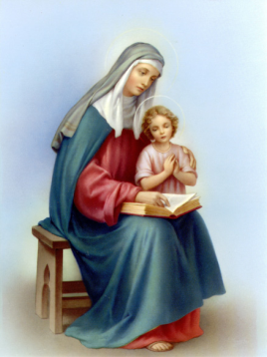
School Houses
Saint Francis
Saint Benedict Saint Cecilia
Saint Anne

Slide 5
School Houses
Siblings are in the same saint house
Own clothes to represent house colour are worn on house feast day
Sports day – children wear house colour t-shirt with navy shorts

Slide 6
SCHOOL TRIPS
Parent Pay
One trip per term
Parent volunteers will need to complete a volunteer form from the office.
Trip letter will be sent out in coming weeks

Slide 7
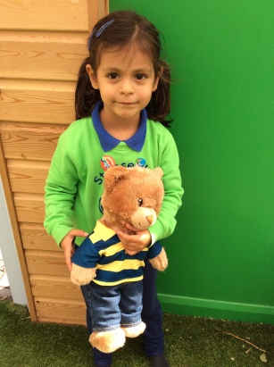
Getting Involved
Parent reading mornings- Monday morning, 8:40 - 8:55am
Stay and play sessions (every Friday 8.40am – 9.10am)
Star Moments (see hand out)
Star of the Day – bear and diary
Focus Child Sheet
TAPESTRY – online learning journal
Parent workshops Autumn/Spring term – Phonics / Maths lessons (Dates TBC)
Hand out available – activities to do with your child at home. *
Just a quick note: Name writing please NO CAPITAL letters except for the first letter of their name – Thank you

Slide 8
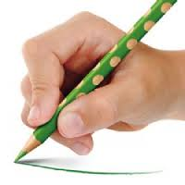
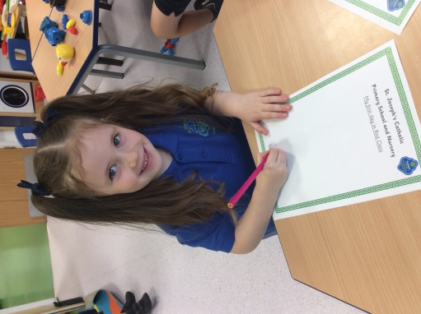
Home School Writing Books
The time your child spends completing their home school writing book activities is less important than his or her understanding of it.
Pencil grip – three fingers ‘tripod’ grip
4 letters sounds a week
Research shows that reading is the single most important thing you can do to help your child's education. It's best to read little and often, so try to put aside some time for it every day. Discussed further at next week’s reading meeting.

Slide 9
School Website
http://www.st-josephs.islington.sch.uk/
Check our weekly blog for reception news, photos and updates!
Curriculum information
Buying uniform and uniform expectations. Please make sure your child is in the correct school uniform-updated-September-2016

Slide 10
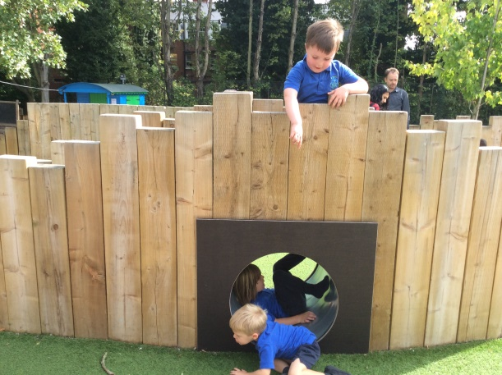
Dates for your Diary
Reading meeting:
Thursday 4th October, 9.15
Welcome Liturgy:
Tuesday 9th October, 9.30
Parents Evening:
Thursday, 18th October 1pm – 7pm (school closes 1pm)
Phonics Workshop – TBC
Thank you!
Any questions?

